Slide 1
EMCH 367 Controls

Slide 2
G1
R(s)
+
C(s)
R(s)
G1+G2
C(s)
+
+
-
+
-
G2
+
G3
G3-G4
-
G4
R(s)
G1+G2
1+(G1+G2)(G3-G4)
C(s)

Slide 3




$$x$$
$$F_{k}=k⋅x$$
Mass
$$f^{∗}\left(t\right)$$
$$F_{d}=c⋅\dot{x}$$

Slide 4
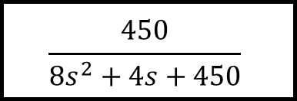
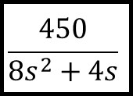
R(s)
$$\frac{450}{8s^{2}+4s}$$
C(s)
+
-
1
R(s)
$$\frac{450}{8s^{2}+4s+450}$$
C(s)

Slide 5
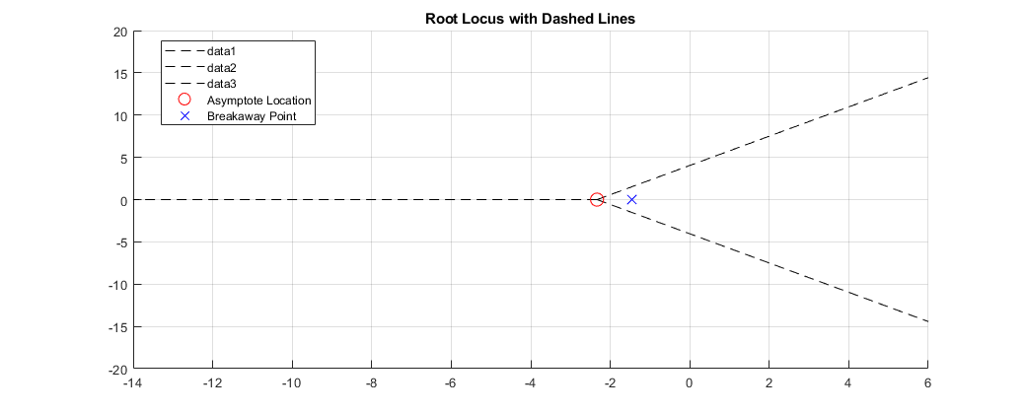



$$θ_{0}$$
$$θ_{1}$$
Breakaway
Point
$$θ_{2}$$

Slide 6
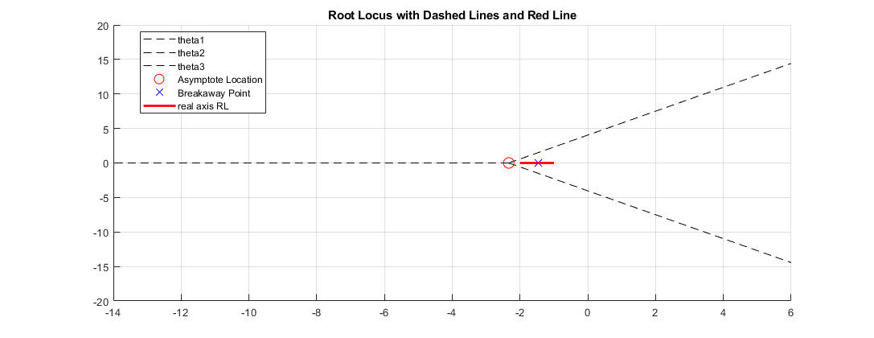
Breakaway
Point
$$θ_{0}$$
$$θ_{1}$$
pole
$$θ_{2}$$

Slide 7
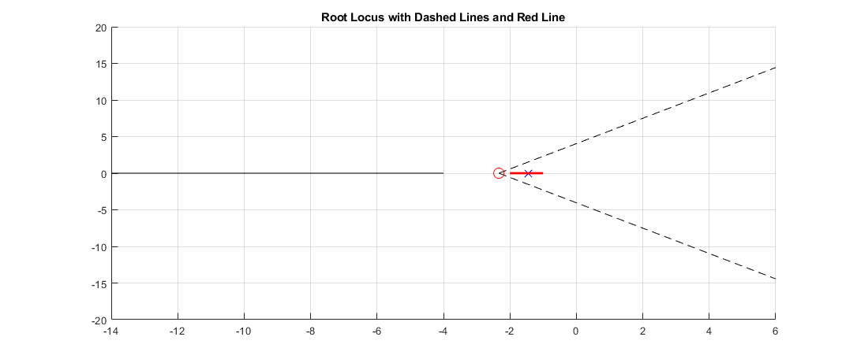


Breakaway
Point

Slide 8
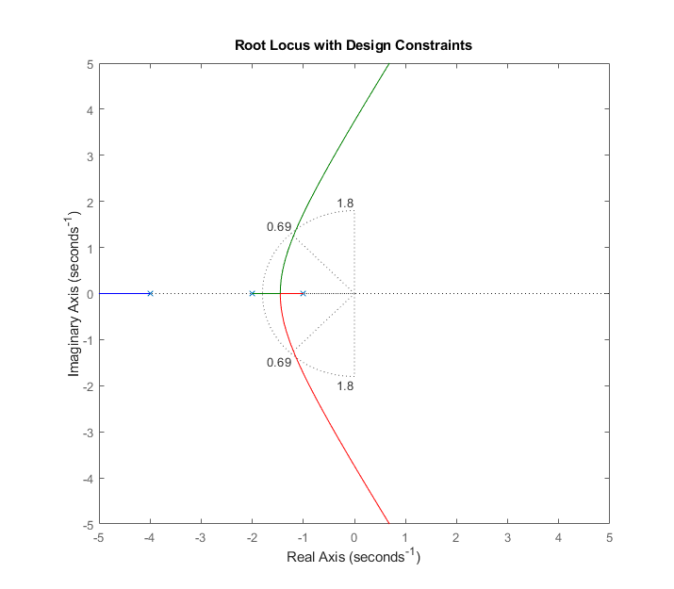

Viable range
$$≈133.63°$$

